Slide 1
ZAS Academy
Python Curriculum for IOT & AI

Slide 2
Day4 - Agenda
Day 3 – Recap: Reversing Int/String, Swapping and Sorting
Dictionary – data type
Bitwise Operators (OR, AND and XOR)
Fibonacci Sequence
String Anargam
Duplicates in an Array
PRIME Numbers
Numpy/Scipy – These are Mathematical & Computational Libraries
Write a program from IGCSE Computer Science Chapter 9 Problem Set
IGCSE – Paper 2 (Reading Home Work)

Slide 3
Known & Useful Functions:
len – to find the length of array or string
range(5) – starts i from 0 to 4 (doesn’t include 5) in increments of 1
range(2, 5) – starts i from 2 to 4 (doesn’t include 5) in increments of 1
range(3, 10, 2) – starts i from 3 to 9 (doesn’t include 10) in increments of 2
% - modulus operator or division
append(2) – to add an element to the array or list

Slide 4
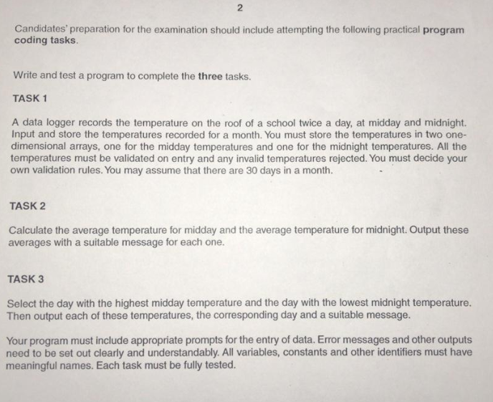

Slide 5
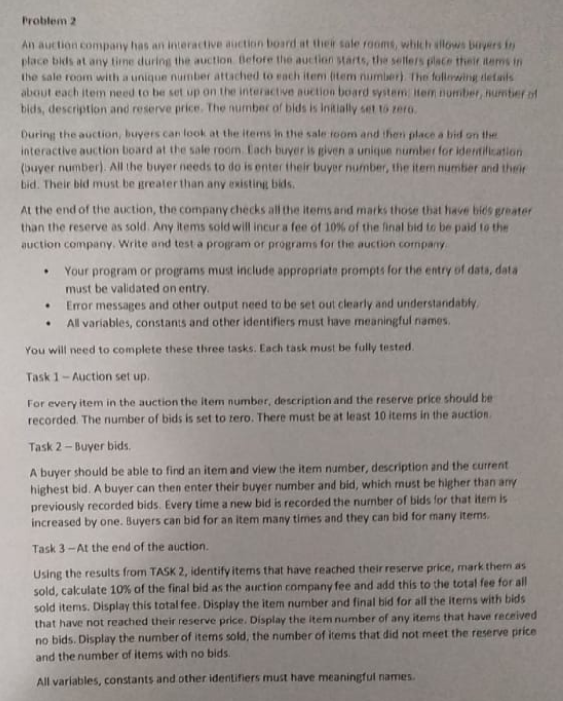

Slide 6
